Slide 1
Mitosis

Slide 2
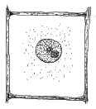
By the end of this lesson, you should be able to:
1. | Explain when and why mitosis is needed.
2. | Outline the steps of mitosis.
3. | Compare the DNA in daughter cells to the DNA found in their parent cells.

Slide 3
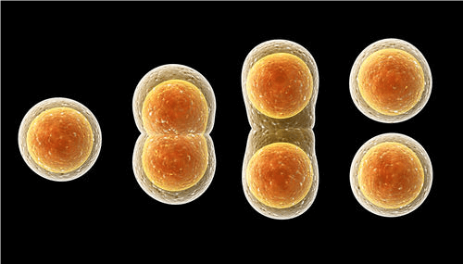
Mitosis is a type of cell division.
Cell division is when one cell splits in half to form two new cells.
The original cell is called the parent cell and the new cells are called daughter cells.

Slide 4
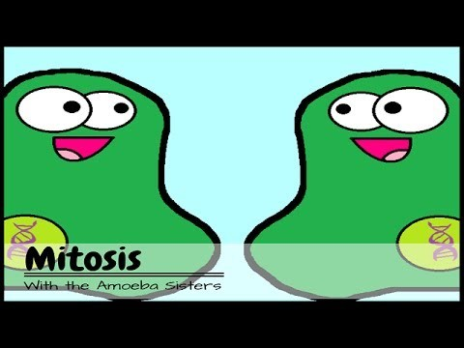

Slide 5
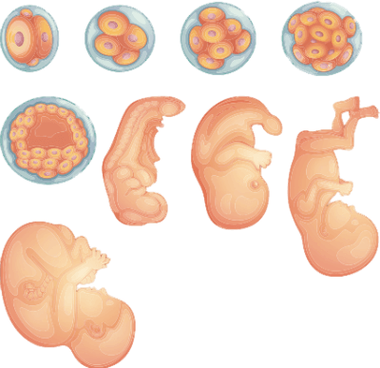
Mitosis is used to make new cells.
By adding new cells to your body, you can grow larger.
You grew from an embryo, to a baby to a young adult by using mitosis to add cells to your body.

Slide 6
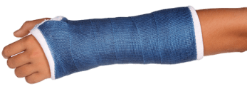
You can also use new cells to replace old or damaged cells.
Every time you recover from injury or illness, damaged cells in your body are being replaced using mitosis.
Joshua, for instance, has a broken arm. There are bone cells in his arm that are damaged and need to be replaced. For Joshua to recover, many cells will go through mitosis to make more bone cells.

Slide 7
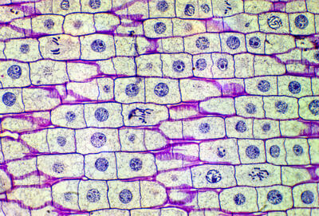
You always have some cells undergoing mitosis, even when you do not have an obvious injury.
In your tissues, there will always be a few cells which are old and are not working as well as they used to.
Through mitosis, they can be replaced by younger cells. This makes sure that all your tissues are healthy and working properly.

Slide 8
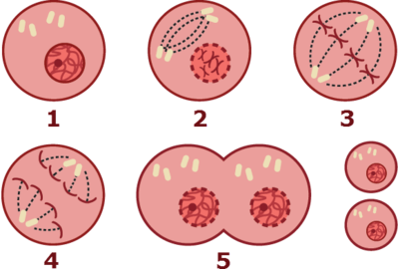
Mitosis involves a series of steps.
Here is a quick overview of the process before we go into each step in more detail.
1. | Before mitosis starts, the parent cell replicates its DNA.
2. | Mitosis then starts with the DNA condensing into chromosomes.
3. | The chromosomes align at the equator of the cell.
4. | Sister chromatids are pulled apart to the poles of the cell.
5. | Finally, the cell membrane pinches off, making two daughter cells.

Slide 9
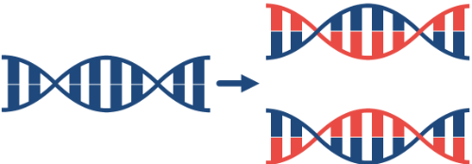
Before mitosis starts, the parent cell replicates its DNA.
This ensures the parent cell has two copies of DNA: one for each daughter cell. This is important because, to function properly, both daughter cells need a full copy of the DNA found in the parent cell.
Once the DNA has been copied, mitosis can begin.

Slide 10
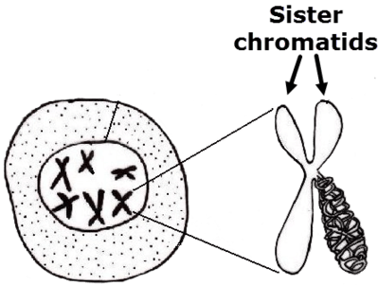
1. Mitosis starts when the DNA condenses into chromosomes.
Chromosomes keep the DNA safe and organized during cell division.
The chromosomes are X shaped because the two copies of DNA made during replication are still attached. The left and right arms of the X are each a copy of the chromosome and are called sister chromatids.

Slide 11
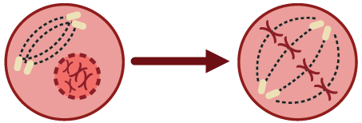
2. The chromosomes form a line down the centre of the cell.
The nuclear membrane breaks down, allowing the chromosomes to line up at the equator (centre) of the cell.

Slide 12
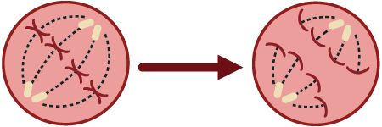
3. The sister chromatids are separated.
Fibres extend from each pole (side) of the cell and attach to the chromatids of each chromosome. The fibres contract, pulling the sister chromatids apart.
Each pole receives one of the sister chromatids. This ensures each pole receives one copy of each chromosome.

Slide 13
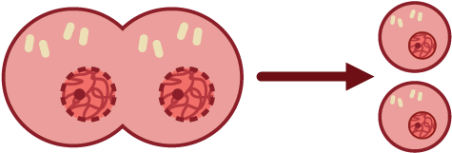
4. The cell is now ready to split in half!
The cell membrane pinches together at the centre of the cell. This divides the cell in half, creating two daughter cells.
At the same time, nuclei form around the chromosomes at either end of the cell, and the chromosomes unravel.

Slide 14
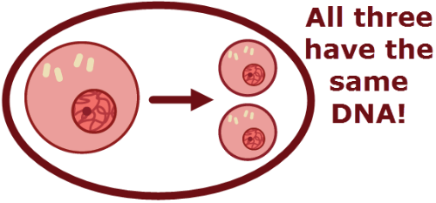
Now mitosis is complete!
We have two daughter cells. They have the same genetic content as one another and as their parent cell.

Slide 15
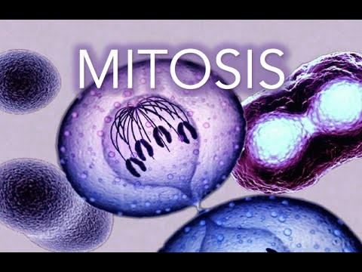

Slide 16
In summary:
Mitosis makes new cells for growth and recovery.
The parent cell replicates its DNA, then mitosis can begin.
1. | Mitosis starts with the DNA condensing into chromosomes.
2. | The chromosomes then align at the equator of the cell.
3. | Sister chromatids are pulled apart to the poles of the cell.
4. | Finally, the cell membrane pinches off, making two daughter cells.
The two daughter cells have identical genetic content to their parent.

Slide 17
